Slide 1


ClickHouse Paris Meetup
Oct 2, 2018
18:30 ClickHouse DBMS. Introduction and Case Studies. Alexander Zaitsev, Altinity
19:15 ClickHouse at ContentSquare. Christophe Kalenzaga & Vianney Foucault
20:00 Pizza Break
20:20 Storetail Data-warehouse Project. Matthieu Jacquet, Storetail (Criteo)
20:45 Pragma Analytics Software Suite w/ClickHouse. Matthieu Texier, Pragma Innovation
21:15 What's new in ClickHouse. Alexey Milovidov, Yandex

Slide 2
ClickHouse Analytical DBMS Introduction
Alexander Zaitsev, Altinity
ContentSquare, Paris, 2 Oct 2018

Slide 3
What Is ClickHouse?

Slide 4
ClickHouse DBMS is
Realtime
Column Store
MPP
SQL
Open Source

Slide 5
ClickHouse Timeline
Developed in Yandex in 2012-2015
Open Sourced June 2016
First non-Yandex deployments Q4 2016
Hundreds of companies by Q4 2018

Slide 6
Why Yet Another DBMS?

Slide 7
Commercial
Analytical
DBMS
OpenSource
Analytical
DBMS
Vertica
MemSQL Actian
SnowFlake
RedShift
…
InfiniDB (MariaDB cs)
InfoBright
MonetDB
GreenPlum
Spark
…
EXPENSIVE
SLOW or LIMITED

Slide 8
Commercial
Analytical
DBMS
OpenSource
Analytical
DBMS

Slide 9
Commercial
Analytical
DBMS
OpenSource
Analytical
DBMS

Slide 10
ClickHouse
Fast!
Flexible!
Free!

Slide 11

How Fast?

Slide 12
:) select count(*) from T;
SELECT count(*)
FROM T
┌───────count()─┐
│ 1261705085657 │
└───────────────┘
1 rows in set. Elapsed: 3.552 sec. Processed 1.26 trillion rows, 1.26 TB (355.22 billion rows/s., 355.22 GB/s.)

Slide 13
“1.1 Billion Taxi Rides Benchmarks”
http://tech.marksblogg.com/benchmarks.html
Query 1 Query 2 Query 3 Query 4 Setup
0.034 0.061 0.178 0.498 MapD & 2-node p2.8xlarge cluster
0.051 0.146 0.047 0.794 kdb+/q & 4 Intel Xeon Phi 7210 CPUs
0.762 2.472 4.131 6.041 BrytlytDB 1.0 & 2-node p2.16xlarge cluster
1.034 3.058 5.354 12.748 ClickHouse, Intel Core i5 4670K
1.56 1.25 2.25 2.97 Redshift, 6-node ds2.8xlarge cluster
2 2 1 3 BigQuery
6.41 6.19 6.09 6.63 Amazon Athena
8.1 18.18 n/a n/a Elasticsearch (heavily tuned)
14.389 32.148 33.448 67.312 Vertica, Intel Core i5 4670K
22 25 27 65 Spark 2.3.0 & single i3.8xlarge w/ HDFS
35 39 64 81 Presto, 5-node m3.xlarge cluster w/ HDFS
152 175 235 368 PostgreSQL 9.5 & cstore_fdw

Slide 14
8 queries 1.3B taxi rides dataset

Slide 15
19 queries, 1200M rows table, 3-node clusters

Slide 16
ClickHouse runs at
Bare metal (any Linux)
Virtualization environments:
Kubernets, VMware etc.
Clouds:
Amazon, Azure, Alibaba

Slide 17
Real companies are using ClickHouse for:
Mobile App and Web analytics
AdTech bidding analytics
Operational Logs analytics
DNS queries analysis
Stock correlation analytics
Telecom
Security audit
Fintech SaaS
Manufactoring process control
BlockChain transactions analysis

Slide 18
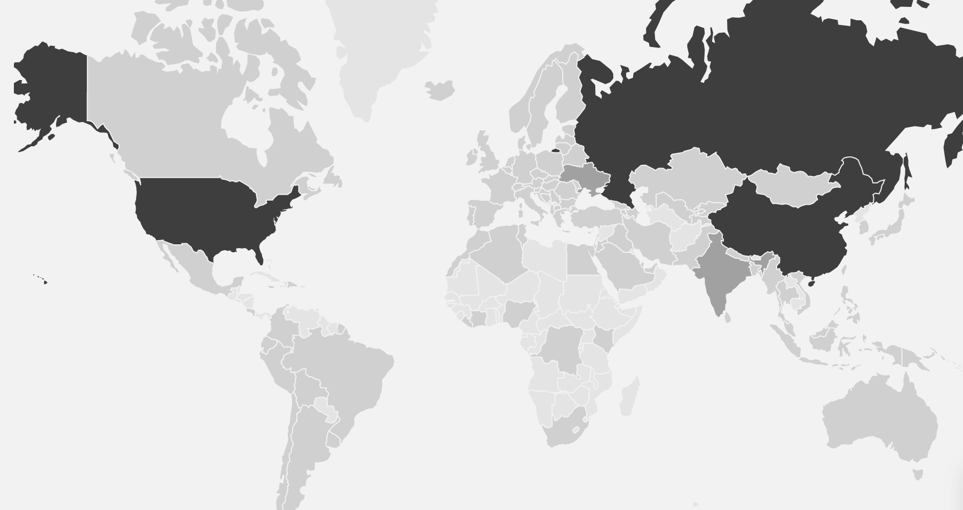
Worldwide
* www.altinity.com visits in 2018

Slide 19
Size does not matter
Yandex: 500+ servers, 25B rec/day
LifeStreet: 60 servers, 75B rec/day
CloudFlare: 36 servers, 200B rec/day
Bloomberg: 102 servers, 1000B rec/day

Slide 20
Happy Migrations!
SPEED!
COST!
VENDOR UN-LOCKING!
From MySQL/InfoBright/PostreSQL/Spark/Elastic
From Vertica/RedShift

Slide 21
Few Case Studies

Slide 22

Ad Tech (ad exchange, ad server, RTB, DMP etc.)
Ad Optimization, programmatic bidding
A lot of data:
10,000,000,000+ events/day
A lot of queries: users and algorithms

Slide 23

Used Vertica, but needed to move
Data sizes constantly grow
Estimated PBs
Vertica license would be too expensive

Slide 24

… migration was not easy
* More details at October 2017 Berlin Meetup

Slide 25
Major Design Decisions
Dictionaries for star-schema design
Extensive use of Arrays
SummingMergeTree for realtime aggregation
Smart query generation
Multiple shards and replicas

Slide 26

Results
Successful migration, 1y+ in production
Better performance and flexibility
75B rows/day
1М rows/sec in peak hours
1.3M SQL queries /day
30% hardware cost reduction (less expensive storage)
No license cost and limits:
3PB of raw data
6,000 billion rows
Powered by:

Slide 27
Case 2. Fintech Company
Stock Symbols Correlation Analysis
5000 Symbols
10 years of data
100B data points

Slide 28
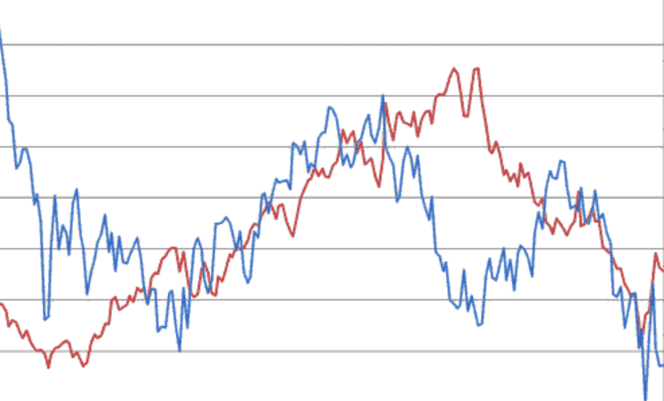

Slide 29
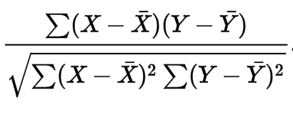
Challenge
(time, symbol, price) – 100 billion
log_return = runningDifference(log(price)) – 100 billion times
corr(s1,s2) = corr(log_return(s1),log_return(s2))
For every pair (s1,s2) from 5000 s(i), 12.5M pairs overall
Group by hours
Calculate 12,500,000 times
For every hour!

Slide 30
Very slow

Slide 31
Tried…
Hadoop
Spark
Greenplum
ClickHouse
Slow
(weeks to complete)
Expensive to scale

Slide 32
2500 tasks
S1
S1
R
S1
S2
S2
R
S2
S3
S3
R
S3
time
symbol
price
time
symbol
logReturn(price)
time
groupArray(symbol)
groupArray(logRet..)
date+hour
corr(S(i),S(j))

Slide 33
POC Performance Results
3 servers setup
2 years, 5000 symbols:
log_return calculations: ~1 h (distributed)
Converting to arrays: ~ 1 h (almost distributed)
Correlations: ~50 hours (also distributed)
12,5M/50h = 70/sec
Distributed => it scales easily!

Slide 34
Case 3. Ivinco
Mature boardreader application
A lot of data collected from different sources
A lot of operational data (performance monitoring)
200TB in MySQL!

Slide 35
Operational problems
Hard to scale
Hard to make HA solution
Performance issues:
‘Manual’ partitioning and sharding
Dozens of indexes per table etc.

Slide 36
Organizational problems
No development resources to rewrite
Minimal changes to current system are allowed

Slide 37
Binary log replication from MySQL to ClickHouse
Queries
Source Data
MySQL
clickhouse-mysql

Slide 38
Results
Seamless integration of ClickHouse into the current system
No developers/coding involved, project is done with DevOps
Easy to test performance side by side (ClickHouse is 100 times faster)
Now ready to re-write main system
More details at:
https://www.altinity.com/blog/2018/6/30/realtime-mysql-clickhouse-replication-in-practice

Slide 39
ClickHouse Today
Mature Analytic DBMS. Proven by many companies
2+ years in Open Source
Constantly improves – new cool features were added recently
Many community contributors
Emerging eco-system (tools, drivers, integrations – Tableaux works!)
Support from Altinity

Slide 40

Q&A
Contact me:
alexander.zaitsev@lifestreet.com
alz@altinity.com
skype: alex.zaitsev
telegram: @alexanderzaitsev
Altinity

